Slide 1
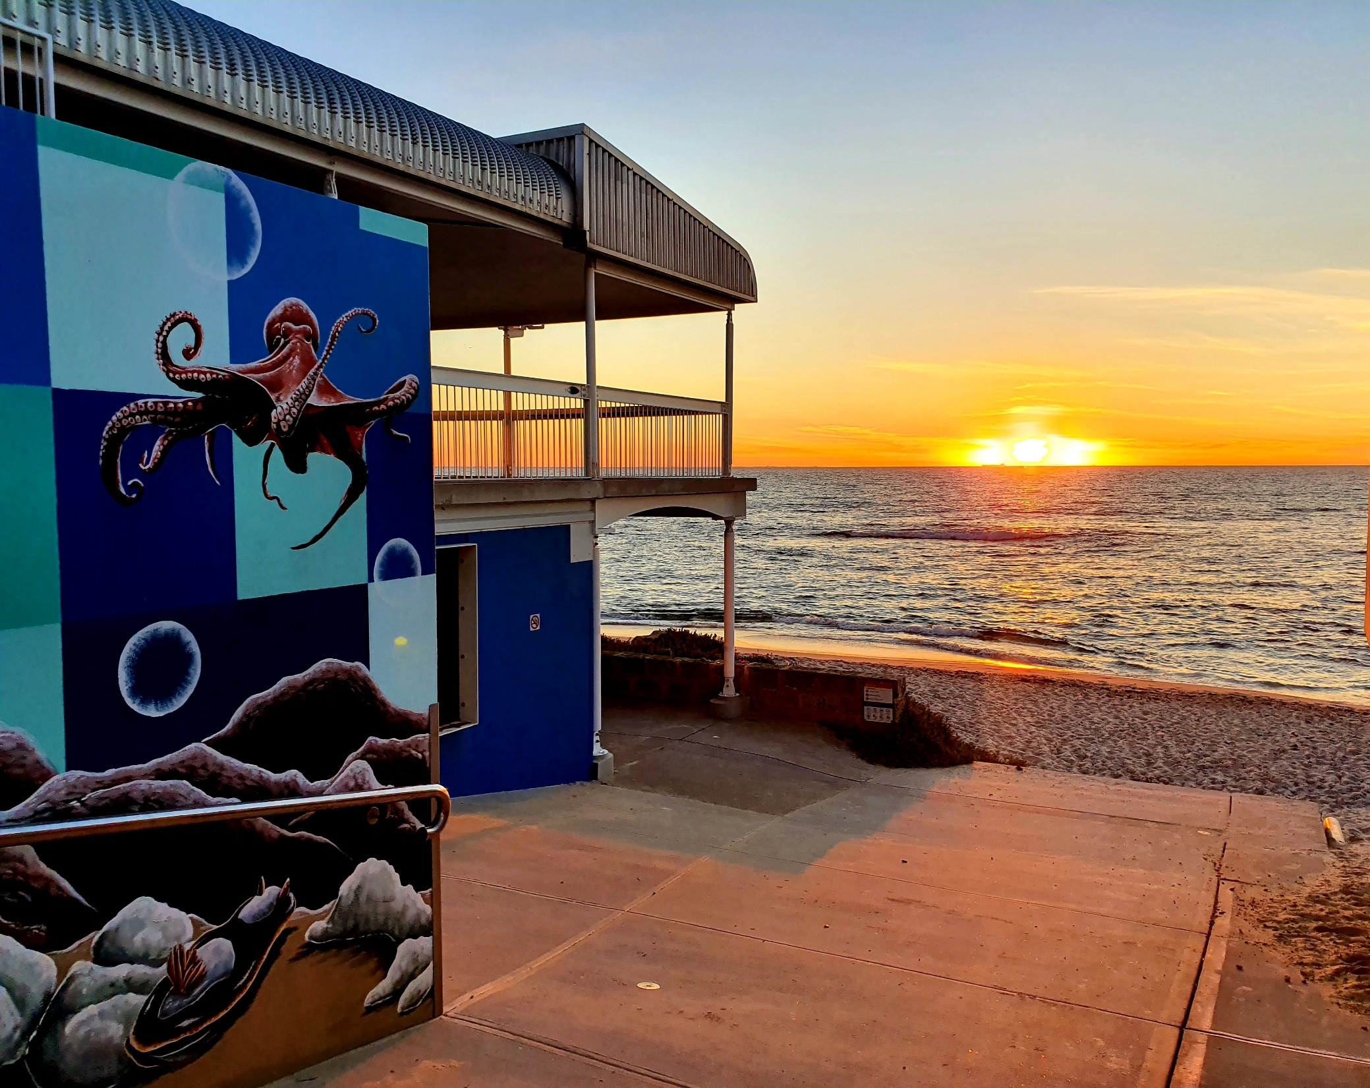
MAAC MONTHLY FISHING COMPETITIONS
ITS AS EASY AS:
1. COMPLETE AND LODGE ENTRY FORM
2. LOG ON
3. LOG OFF AND WEIGH YOUR CATCH IN

Slide 2
1. COMPLETING THE ENTRY FORM
ONE PER BOAT/VESSEL
BLANK ENTRY FORM LOOK LIKE THIS…

Slide 3
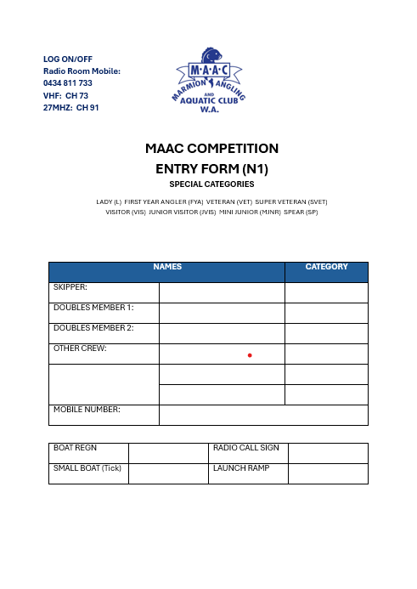

Slide 4
1. COMPLETING THE ENTRY FORM (CONT.)
Completed form looks like this…

Slide 5
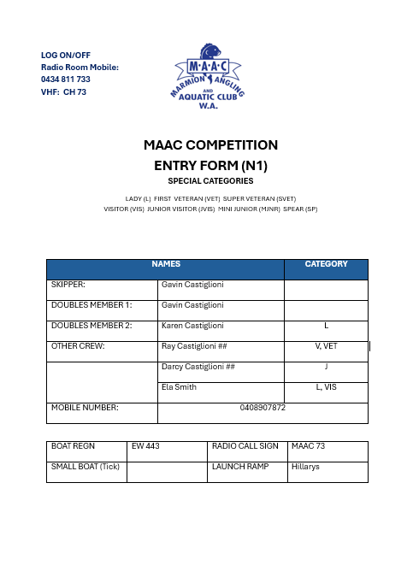

Slide 6
1. COMPLETING THE ENTRY FORM (CONT.)
SPECIAL CATEGORIES:
LADY (L). FEMALE OVER 18 YEARS OF AGE.
VETERAN (VET). OVER 60 YEARS OF AGE AT THE START OF THE YEAR.
VISITOR (VIS). INVITED TO FISH BY A MEMBER.
JUNIOR VISITOR (JVIS). AT LEAST 10 YEARS OLD AND MUST BE RELATED TO A MEMBER.
JUNIOR (JNR). MEMBERS AGED BETWEEN 10 AND 18 AT THE START OF THE YEAR.
MINI JUNIOR (MJNR). RELATIVES OF MEMBERS UNDER THE AGE OF 10.

Slide 7
1. COMPLETING THE ENTRY FORM (CONT.)
SMALL BOAT: 5 METRES OR LESS IN LENGTH.
STILL NOT SURE?
THE MAAC CAPTAIN WOULD BE HAPPY TO MEET FIRST TIME ANGLERS AT THE CLUB ON A FRIDAY EVENING AND GUIDE THEM THROUGH THE PROCESS.

Slide 8
1. LODGING THE ENTRY FORM
COMPLETED FORM MUST BE LODGED BY EITHER:
  PLACING IN THE COMPETITION BOX ON THE FRIDAY BEFORE THE COMPETITION. THE BOX WILL BE IN THE CLUB OFFICE DURING OFFICE HOURS AND THEN IN THE SOUTHERN BAR FROM ABOUT 5.00PM UNTIL 7.00PM.
  LODGING WITH THE FIELD DAY OFFICER IN THE BOAT SHED ON THE MORNING OF THE COMPETITION FROM 5.00AM (OCT – MARCH) 0R 6.00AM (APRIL – SEPTEMBER).
$5 FOR EACH SENIOR ANGLER ON THE FORM MUST BE INCLUDED WITH THE ENTRY FORM (THIS GETS A FREE BEER/WINE AT THE WEIGH IN!)
JUNIOUR ANGLERS DO NOT REQUIRE A PAYMENT.

Slide 9
2. LOG ON
TO COMPLETE THE ENTRY PROCESS, ANGLERS MUST “LOG ON”.
ANGLERS CAN START TO LOG ON FROM 5.00AM (OCT – MARCH) 0R 6.00AM (APRIL – SEPTEMBER), UP UNTIL 9.00AM.
ANGLERS CAN LOG ON VIA MOBILE 0434 811 733, VHF RADIO CH 73.
INFORMATION TO BE PROVIDED WHEN LOGGING ON IS: RADIO CALL SIGN, NUMBER OF ANGLERS COMPETING, AMOUNT OF FUEL, DESTINATION AND EXPECTED TIME OF RETURN.
NOTE. THE MAAC RADIO SERVICE IS FOR LOGGING ON AND OFF FROM THE FISHING COMPETITION. IT IS NOT A SEA RESCUE SERVICE – ANGLERS SHOULD ALSO LOG ON SEPERATELY WITH SEA RESCUE

Slide 10
3. LOG OFF AND WEIGH IN
LOG OFF:
ANGLERS MUST LOG OFF BY 4.30PM. FAILURE TO LOG OFF WILL RESULT IN BOTH THE SKIPPER AND CREW BEING DISQUALIFIED.
ANGLERS CAN LOG OFF VIA MOBILE 0434 811 733, VHF RADIO CH 73 (SAME OPTIONS AS LOGGING ON).

Slide 11
3. WEIGH IN
ANGLERS ARE ABLE TO WEIGH IN THEIR CATCHES FROM 12.00PM.
ANGLERS MUST BE IN THE WEIGH IN QUEUE AT THE BOAT SHED BY 4.00PM.
INDIVIDUAL CATCHES MUST BE SEPARATED BEFORE BEING PRESENTED AT THE WEIGH IN.
COMMITTEE MEMBERS WILL BE AVAILABLE TO HELP FIRST TIME ANGLERS THROUGH THE PROCESS.
FISH MUST BE BAGGED IN A HESSIAN BAG OR NATURAL FIBER BAG NOT PLASTIC.
AFTER HAVING THEIR CATCH WEIGHED IN, ANGLERS GET A FREE BEER (OR WINE)

Slide 12
3. WEIGH IN – PRIZES AND THE SCORING SYSTEM
MONTHLY PRIZES FALL INTO TWO CATEGORIES:
THE HEAVIEST FISH FOR CATEGORIES OF HERRING, GARFISH, SAND WHITING, KING GEORGE WHITING, FLATHEAD, TAILOR, SKIPPY, SAMSON FISH AND SHARKS. PRIZES ARE ALSO AWARDED FOR THE HEAVIEST PINK SNAPPER, DHUFISH, BREAKSEA COD, AND BALDCHIN GROPER – OUTSIDE OF THE DEMERSAL BAN.
CATEGORIES OF ANGLERS (E.G. VETERANS, DOUBLES) WHO RECORD THE HIGHEST SCORE FOR THEIR PARTICULAR CATEGORY. THE SCORING SYSTEM IS BASED ON TWO POINTS PER SPECIES OF FISH AND ONE POINT FOR EACH KILO OF TOTAL WEIGHT.
  FOR EXAMPLE, IF AN ANGLER CAUGHT 5 SPECIES AND HIS/HER TOTAL CATCH WEIGHED 6 KILOS – HIS/HER SCORE WOULD BE 31 POINTS (5 x 5 + 6).

Slide 13
3. WEIGH IN – PRIZES AND THE SCORING SYSTEM (CONT)
PRIZES (BASED ON POINTS) ARE AWARDED FOR THE FOLLOWING CATEGORIES:
SINGLES – WINNER AND RUNNER UP
DOUBLES – WINNERS AND RUNNER UP
MOST SPECIES - WINNER
LADIES – WINNER
VETERANS – WINNER AND RUNNER UP
JUNIORS/MINI JUNIORS – WINNER AND RUNNER UP
VISITORS – WINNER AND RUNNER UP

Slide 14
PRESENTATION AND BBQ
PRESENTATION OF THE PRIZES TAKES PLACE IN THE BOAT SHED COMMENCING AT 6.30PM
FOLLOWING THE PRESENTATION A BBQ TAKES PLACE IN THE BOAT SHED.
THE CAPTAIN’S BAR WILL BE OPEN FOR DRINKS TO BE PURCHASED.
$12.50 WILL GET A PLATE WITH STEAK AND 2 SAUSAGES. THERE ARE ALSO SALADS AND BREAD ROLL AVAILABLE – INCLUDED IN THE PRIC, CARD AND CASH IS ACCEPTED.
IF YOU FISH IN THE COMP, THE MEAT PACK WILL COST $5
CAN COOK OWN CATCH.
RAFFLES ARE AVAILABLE.
A PARTICIPATION PRIZE – MUST BE IN ATTENDANCE TO WIN

Slide 15
OTHER MATTERS
OTHER MATTERS TO BE AWARE OF:
THE COMPETITIONS ARE NORMALLY RUN THE FIRST SATURDAY AFTER THE FIRST SUNDAY OF THE MONTH.
COMPETITION FOR THE DAY IS CANCELLED IF EITHER:
  A STRONG WIND WARNING IS ISSUED BY BOM ON THE MORNING OF THE EVENT.
  LESS THAN 8 BOATS LOG ON BY THE SCHEDULED START TIME.
ALL FISHERIES REGULATIONS ARE REQUIRED TO BE COMPLIED WITH.
AN ANGLER’S CATCH CAN ONLY CONSIST OF SPECIES THAT ARE ON THE MAAC ELIGIBLE SPECIES LIST.

Slide 16
OTHER MATTERS (CONT)
THE RULES HAVE BEEN EXPANDED WITH EFFECT FROM 2022 TO PROVIDE FOR ANGLERS FISHING FROM PERSONAL WATER CRAFT (E.G. JET SKIS) AND PADDLE CRAFT (E.G. KAYAKS).
A COPY OF THE CURRENT MAAC FISHING COMPETITION RULES IS AVAILABLE FROM THE MAAC OFFICE.
DISCLAIMER
All competitors taking part in a MAAC Club fishing competition or other competition sanctioned by the Club do so entirely at their own risk. The MAAC will not be held responsible for any loss or damage whatsoever sustained by any competitor to their person, property or effects.

